Slide 1
Bite sized training sessions:
Process Modelling – Part 2 of 2
Process Model Documentation
Notes:
NOTES

Slide 2
Objectives
To understand
  What is a process model
  Why do process modelling
To be able to
  Read a process model
  Build a process model
  Critically review a process model

Slide 3
Recap

Slide 4
What are process models
Models business process requirements for a solution – computerised or not.
Defines only the process requirements for the solution.
Is – by definition – the process scope of the solution.
It should be possible to trace back every component of a process model to the objectives it helps achieve
Process models consists of 4 components…

Slide 5

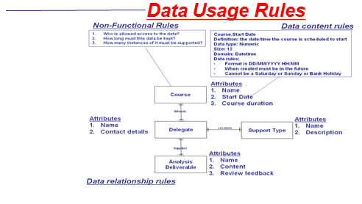
Process models consists of 4 components…
Process execution rules
A BA can request one of 4 types of support:
Phone or email based query about a specific point
Informal review of a project deliverable
Formal review of full set of project deliverables
Facilitated workshop of how to apply analysis to a specific project
1. In the case of phone or email query about a specific point
the BA poses the question and the training provider will provide guidance for how the technicalities of Business Analysis apply to the problem
Informal reviews of project deliverables will be done by email and will only discuss the technicalities of Business Analysis in relation to the document
Formal reviews will involve the BA sending the full set of Analysis deliverables to the training provider who will critique them from a technical perspective and then deliver the feedback in a one-to-one structured feedback session on the client site
Facilitated workshops will be initiated by the BA - the training provider will supply workshop agenda and prerequisites which the BA will use to organise the workshop. The training provider will then facilitate the workshop for the project.
Non-functional Rules
Who is interacts with process
Where they are
Availability of process
Volumetrics
Performance of process
Security & Authorisation levels
Process dependency rules
BA requests
support
Conduct
Training
Provide
BA support
Analysis Phase
Of Project
concludes
Monitor
Analysis
quality

Slide 6
Process Execution Rules

Slide 7
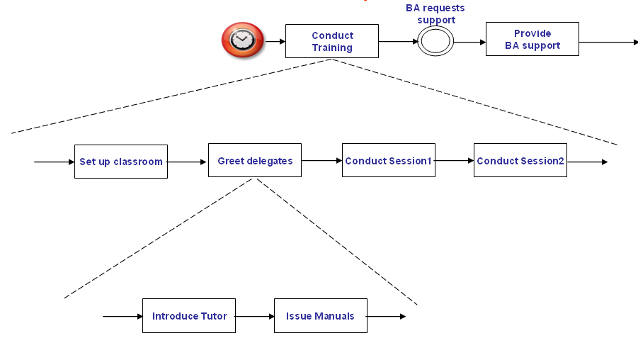
Remember Process Decomposition?
Activities
Top level
+
+
Sub-Process
Intermediate levels
+
+
+
+
Task
Bottom or atomic level
Notes
A process model does not have to be decomposed.
Each level of these processes/tasks must ‘balance’ with the level it is a decomposition of: if a process has one input and that process is decomposed, then the input must also be input to at least one sub-process/task on the decomposition and there can be no other inputs although the single input can trigger more than one sub-process/task.

Slide 8

When NOT to specify Process Execution Logic
Summary processes, by definition, are not the bottom or atomic layer in a process model.
Definition of summary processes is therefore going to be a summary definition of the scope of processes within them.
It is not feasible (or desirable) to specify precise execution logic for a summary processes as it would be impossible to ascertain which atomic process each statement belonged to.
What is useful to define at summary process level is
  Description of the process at the level shown on the diagram.
  Metrics provided that they apply only to the process at the level it is shown on the diagram.
But, as my old zombie mother used to say,
“don’t decompose unless you HAVE to!”

Slide 9

When to specify Process Execution Logic
Atomic processes, by definition, are the bottom or atomic layer of a process model.
Therefore it will be necessary to document
  a description of the process
  the precise logic that must be executed by the process.
Or as my old zombie mother used to say
“Only do it when you have finished decomposing…”

Slide 10
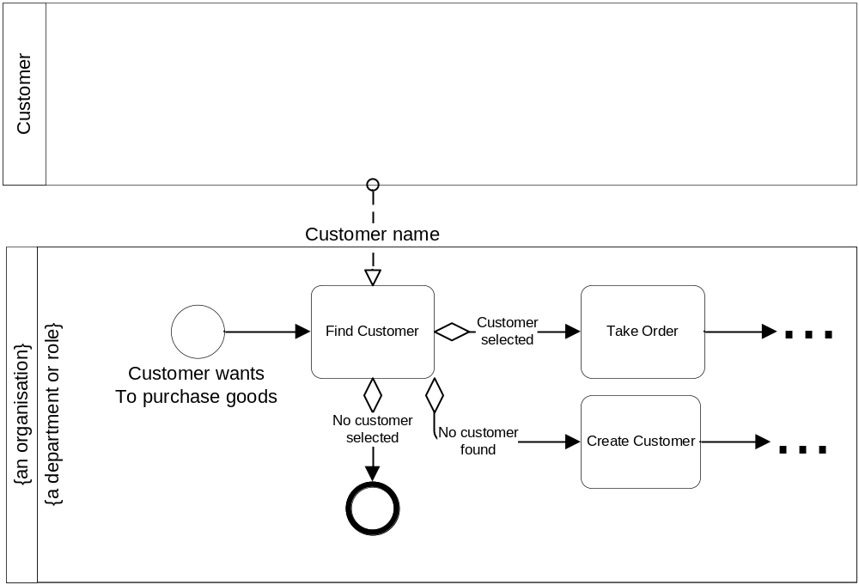
For example…

Slide 11
Process Descriptions
Description of a process/task: a natural English description of what the process is for and an overview of how it does it.
Example description for Find Customer process:
“The process Find Customer allows the user to select the right customer from a list of possible ones.
The list of possible Customers are found by using certain search criteria but if none are found then the process Create Customer is triggered.”
Ensure that you always stay within process scope – as defined by what triggers it with what, and what it can trigger with what…as defined on the process model!

Slide 12
Process Execution Logic
Not descriptions, but definitive statements.
Execution Logic: there are a variety of ways of doing this ranging from
  natural English to…
  …scenario based (good for use case diagrams)…
  …structured English…
  …pseudo code…
  …highly specialised and formalised notations such as Zed.
The most common methods that strike a balance between these two extremes are structured English and pseudo-code.
Ensure that you always stay within process scope – as defined by what triggers it with what, and what it can trigger with what…as defined on the process model!

Slide 13
Scenario based
English used to describe the bulk of the specification.
Agree the format with customer and suppliers of your information – UML has many styles for this and levels at which it can be documented
Formats can include
  Business scenario
  Pre and post conditions
  Happy path scenario
  Alternatives and exceptions
Example for Find Customer
  Scenario starts when a Customer wants to purchase goods.
  Pre conditions:
    The customer is able to supply information
  Post conditions:
    Customer found Take Order triggered or
    Customer not found and Create Customer triggered or
    Process ends
  Happy path
  The solution prompts the user for the customer name
  The user supplies the customer name
  The solution presents a list of matching customers
  The user selects the desired customer
  The solution triggers Take Order passing the Customer Number
  Alternatives
    4.7 there are no matching customers
      The solution triggers Create Customer
    4.8 The user does not select a Customer
      End process

Slide 14
Structured English
English used to describe the bulk of the specification.
The reserved words and phrases typically include
  Create
  Read
  Update
  Delete
  For each … end for each
  If … else … end-if
  Go to
  Display
  Input
  Prompt
  Invoke
  Stop / exit
  Etc! Agree with the customers and suppliers of this information.
Example for Find Customer
  Prompt the user to input a Customer Name
  For each Customer where the Customer Name = input Customer Name
  Display Customer Name
  Customer Address
  Customer Number
  End for each
  If no Customers were found
  Then invoke the process Create Customer
  End if
  Prompt the user to select the correct Customer from the list
  If no Customer selected
  Then stop
  End-if
  Invoke process Take Order passing selected Customer

Slide 15
Pseudo Code
Pseudo-code takes this one stage further and represents the logic in the programming style of the language to be used to code the solution. As such it will where feasible use the syntax of that language.
Example for Find Customer:
  Procedure Find_Customer
  Declare Input_Customer_Name Char(50) init(‘’)
  Declare Selected_Customer_Number Pic(999999999) init(0)
  Declare Found Boolean init False
  Display “Please enter the customer name: ” & Input_Customer_Name
  Do while ¬EOF Customer
  Read Customer
  If Customer.Name = Input_Customer_Name then
  Display Customer_Name
  Display Customer_Address
  Display Customer_Number
  Found=True
  End-if
  End Do-while
  If ¬Found then go to procedure Create_Customer
  End-if
  Display “Please select Customer to proceed” Selected_Customer_Number
  If Selected_Customer_Number = 0
  Then end Procedure Find_Customer
  End-if
  Invoke go to procedure Take_Order(Selected_Customer_Number)
  End Procedure Find_Customer

Slide 16
Exercise
Document 1 or 2 process steps from your process model
  Process description
  Process execution logic using scenarios or structured English
The business users are available to answer any scope or requirements questions.
If you need to make any assumptions document them.
Time: 20 minutes.
Deliverable: flipchart specification.

Slide 17
Process Non-Functional Rules

Slide 18
We only know what a non-functional isn’t…
…and it isn’t a functional requirement!
The usual ones are
  How many users can use it concurrently. Example: up to 100 concurrent users.
  Where (physically) it can be run. Example: The Call Centre at No 1 The High Street, Anytown.
  When it is available for use. Example: 08:00 to 18:00 Monday to Saturday excluding Bank Holidays.
  How often it is run. Example: up to 1,500 transactions per hour.
  How quickly it should execute. Example: it should take no longer than 5 seconds to find a customer.
  How reliable it should be. Example: no more than 2 un-planned system unavailable events per year.
  Any usability Non-Functional Requirements. Example: allow the order in which data items are supplied to be customised.
  Etc!
…and anything else which is not a functional requirement (and not documented somewhere else)!
Ref: Article on NFR in the BA Training sharepoint site
Is “Who can use a process” a non-functional requirement?

Slide 19
Remember Process Decomposition?
Activities
Top level
+
+
Sub-Process
Intermediate levels
+
+
+
+
Task
Bottom or atomic level
Notes
A process model does not have to be decomposed.
Each level of these processes/tasks must ‘balance’ with the level it is a decomposition of: if a process has one input and that process is decomposed, then the input must also be input to at least one sub-process/task on the decomposition and there can be no other inputs although the single input can trigger more than one sub-process/task.

Slide 20
When can Non-Functional Requirements be specified?
At the highest level in the process hierarchy where they will apply to all processes contained within a summary process
For “Conduct Training” which of the following Non-Functional Requirements can be applied
  Available Monday to Friday
  Available 09:00 to 17:00
  Runs 4 times per day: 2 trainers x 2 training courses (each has 2 sessions) per day
+
+
+
+
+
+

Slide 21
Exercise
For the 1 or 2 process steps from your process model you documented process execution logic, document as many Non-Functional Requirements as are relevant from the following list
  Accessibility Non-Functional Requirements
  Accuracy Non-Functional Requirements
  Availability Non-Functional Requirements
  Backup and Recovery Non-Functional Requirements
  Compatibility Non-Functional Requirements
  Concurrency Non-Functional Requirements
  Legal and Regulatory Non-Functional Requirements
  Performance Non-Functional Requirements
  Reliability Non-Functional Requirements
  Security Non-Functional Requirements
  Throughput Non-Functional Requirements
  Etc, etc, etc!

Slide 22
The business users are available to answer any scope or requirements questions.
If you need to make any assumptions document them.
Time: 15 minutes.
Deliverable: flipchart specification.

Slide 23
Process Data Usage Rules

Slide 24
Data that processes need in order to be able to execute
Each task will CRUD (create, read, update, delete) data entities.
A CRUD matrix specifies which data entities tasks create, read, update and/or delete. Typically a task will CRUD many data entities.
  For example, “Find Customer” will read the Customer entity.
All entities should as a minimum be created and read by one or more tasks.
How data entities relate to each other and the other business rules defined for entities is not covered within this module.

Slide 25
Exercise
For the 1 or 2 process steps from your process model you documented, define the data CRUD for the data entities on your data model.
The business users are available to answer any scope or requirements questions.
If you need to make any assumptions document them.
Time: 15 minutes.
Deliverable: flipchart specification.

Slide 26
End

